Slide 1
There are 59K Restaurants
which serves PIZZA as well

Slide 2
Out of 59K restaurantes, 75% got 4 or more ratings out of 5.

Slide 3
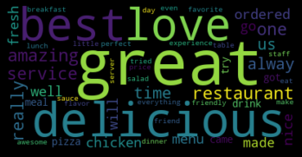
Specific words user were used to rate these restaurants are as

Slide 4
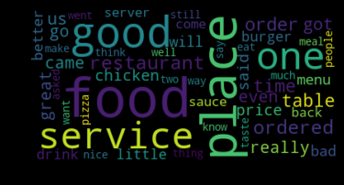
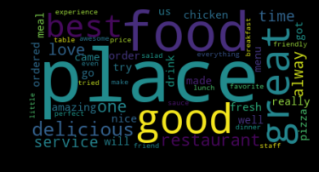
Which has been distinguished in two type : Bad and Good
BAD GOOD

Slide 5
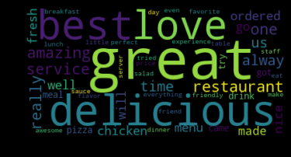
For only our Marketing Team based on the business requirement below words are the perfect match to get noticed

